Slide 1

Fraud detection:
Fighting the False Positives.

Slide 2

Problem
1 in 5 transactions declared as fraud are truly fraud
$9 billion is the cost of real fraud in a year
$118 billion is the cost of blocked sales in a year
Source: Javelin Strategy & Research report (Pascual and Van Dyke, 2015)

Slide 3
Impact
26% of shoppers whose cards were declined reduced their shopping at that merchant following the decline
32% stopped entirely
Millions lost by card issuers in interchange fees when card holders use a different card after the decline
Source: Javelin Strategy & Research report (Pascual and Van Dyke, 2015)

Slide 4
Goal
Predict fraud, minimizing the amount of false positives
Explore the role of autoencoders in fraud detection

Slide 5
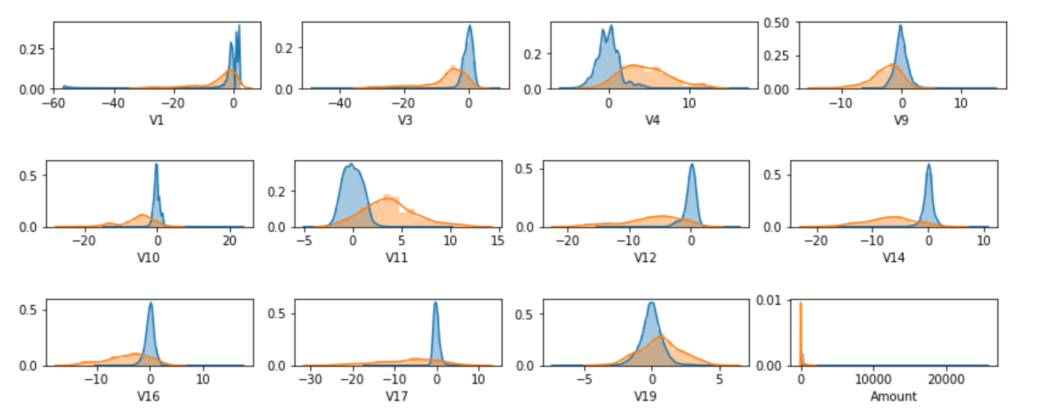
Dataset
Kaggle credit card dataset
28 masked features + Time + Amount
284,807 transactions, 492 frauds (0.17%): Imbalanced
Splitting: 200,000 training, 50,000 for validation, 34,807 for test

Slide 6
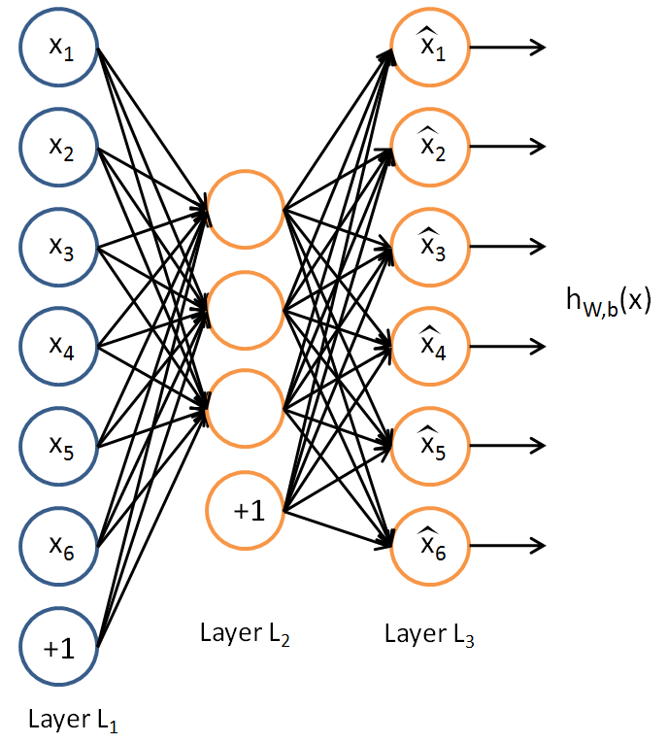
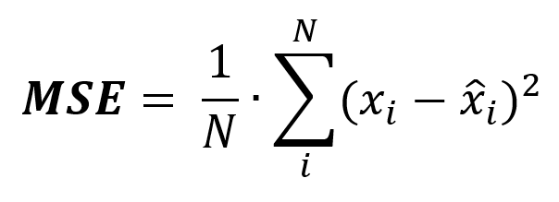
Autoencoders
Unsupervised Learning
Objective: Reconstruct the input minimizing the Mean Squared Error (MSE)
Image source: http://ufldl.stanford.edu
Notes:
The mean squared error is the average of the squared difference between the input and the output

Slide 7

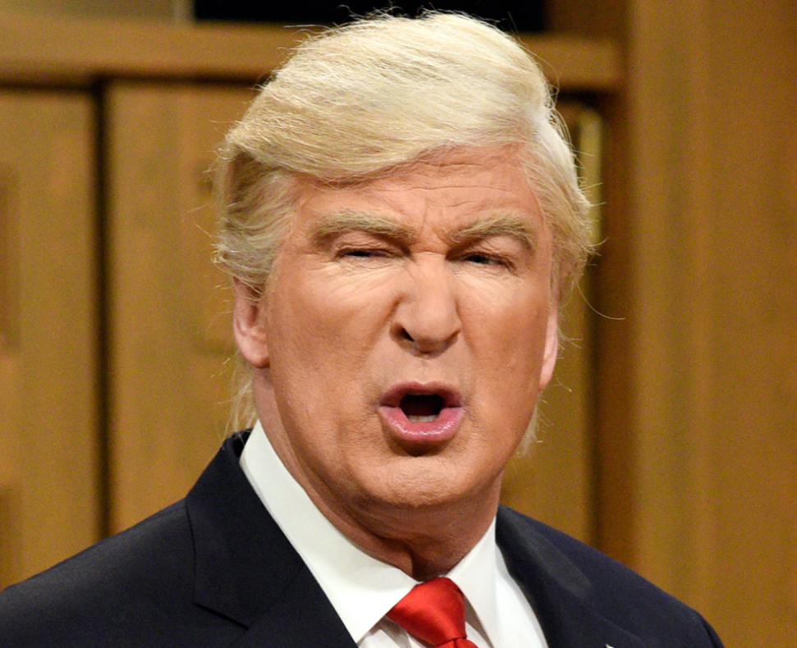
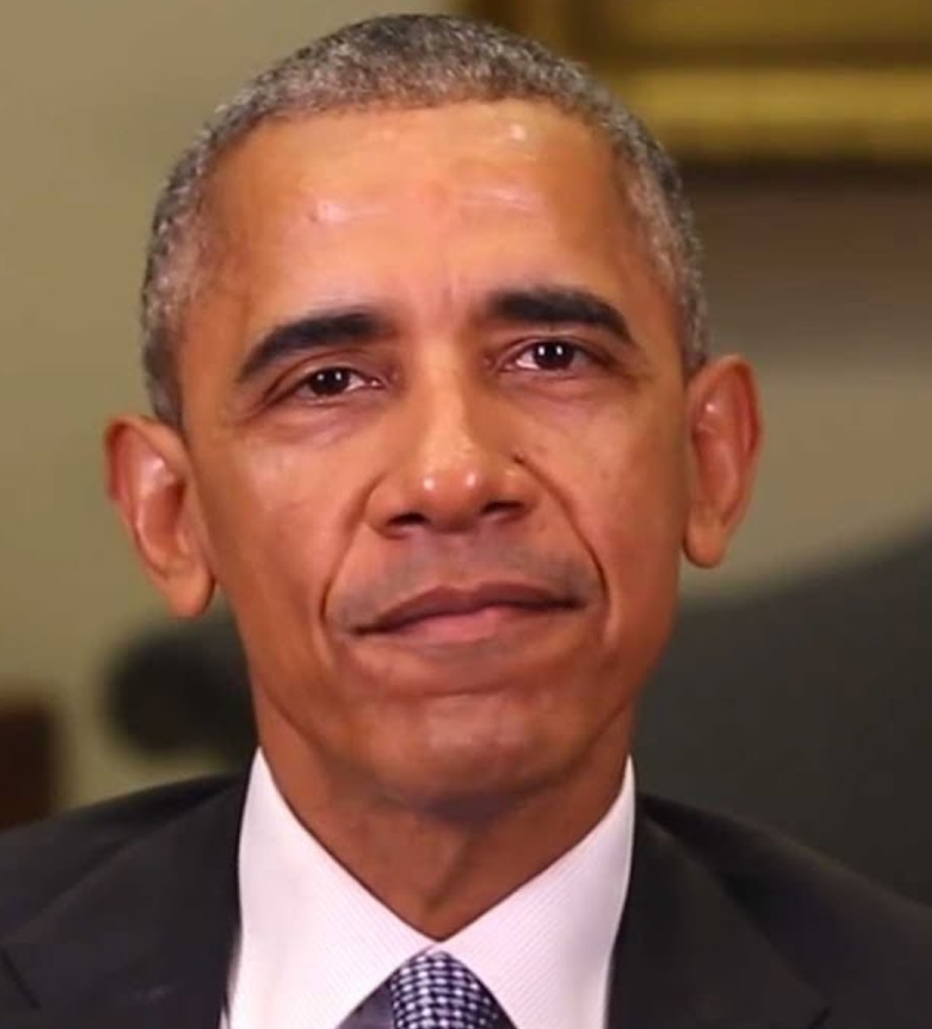
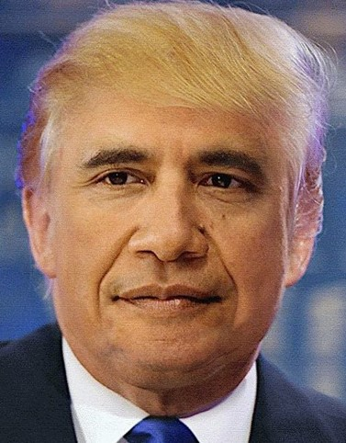


Autoencoders in anomaly detection
Train autoencoder with normal transactions
Low MSE
High MSE

Slide 8

Autoencoders implementation
2 encoding layers autoencoder
2 encoding layers H2O autoencoder
2 encoding layers with tied weights: encoding weights are forced to be equal to decoding weights
2 encoding layers Variational Autoencoder: force the compressed representation to follow a unit gaussian distribution
Training: 199,659 non-fraudulent transactions
Validation: 50,000 transactions, 91 frauds
Test: 34,807 transactions, 60 frauds
Input: 53 nodes
Output: 53
20
10
5
10
20
Notes:
We used an a

Slide 9
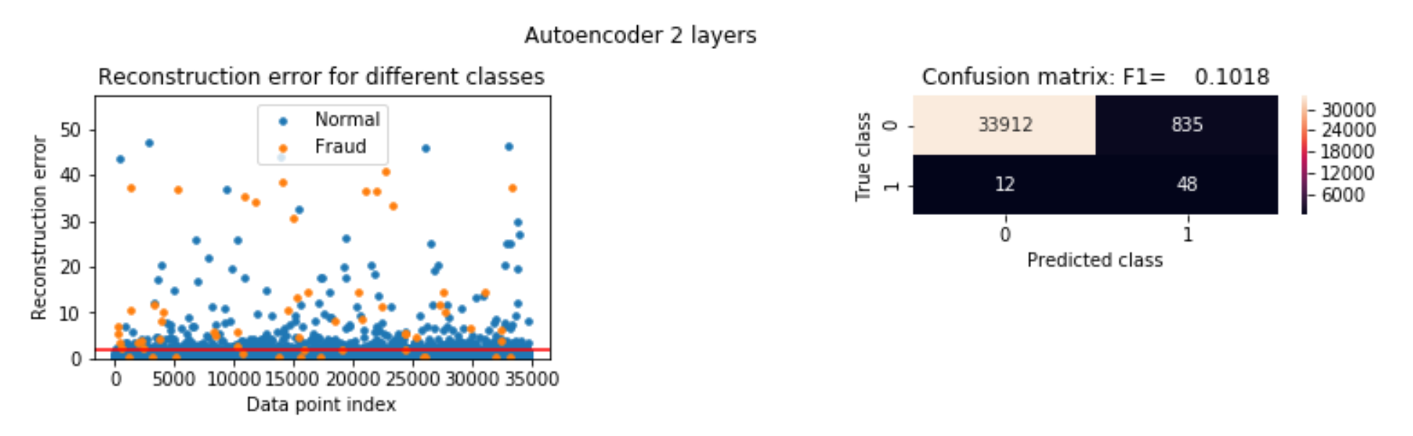
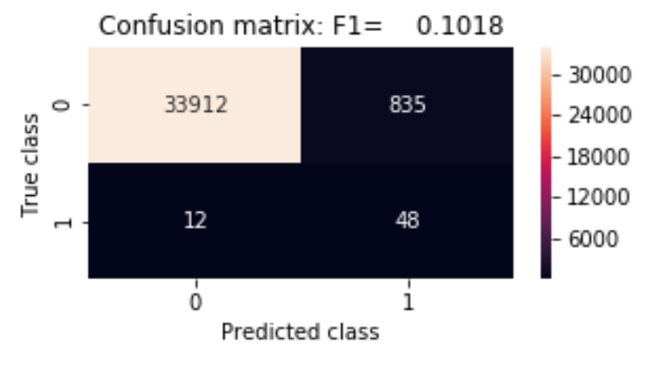
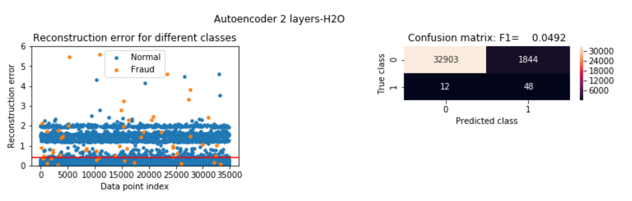
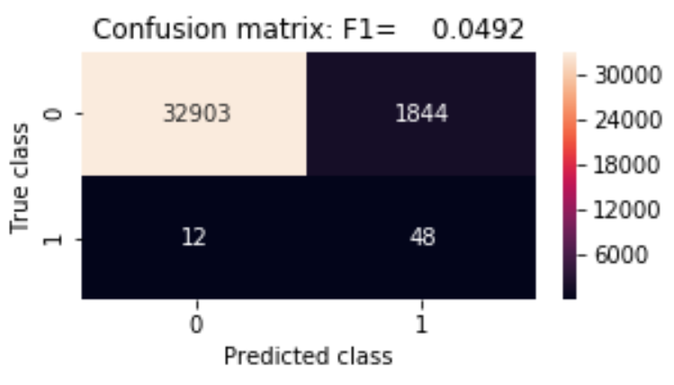
Autoencoder results on test set

Slide 10
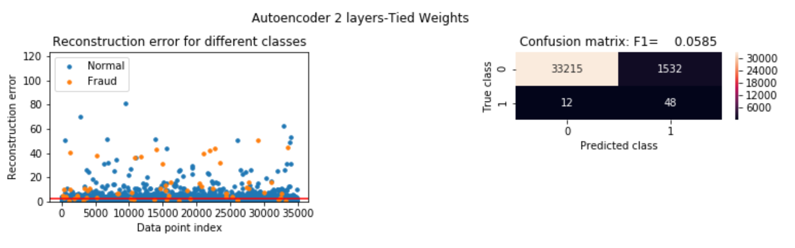
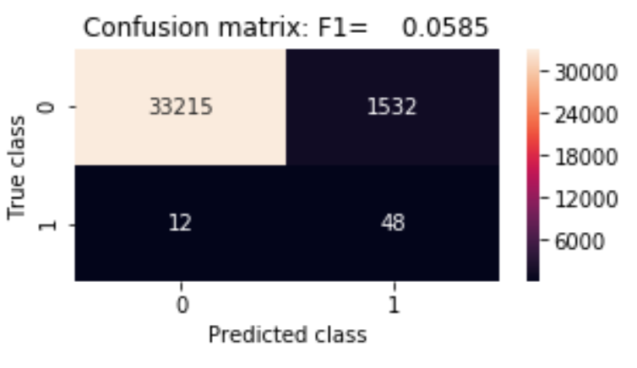
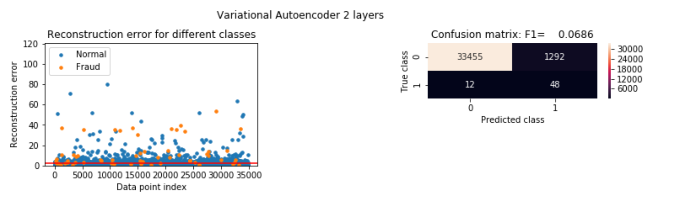
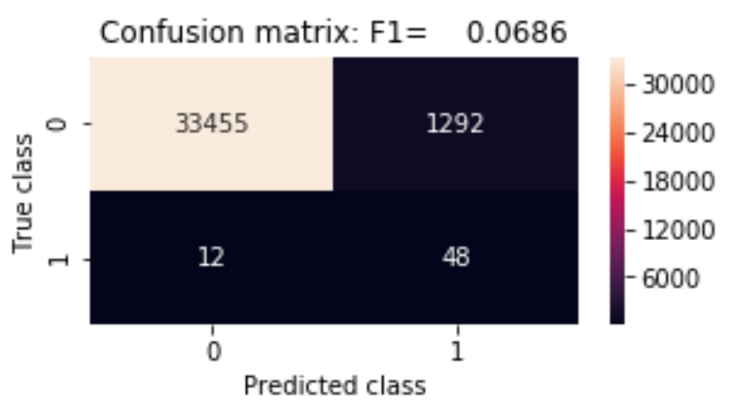
Autoencoder results on test set

Slide 11
Autoencoder Summary
Model | Precision | Recall | F1 Score | False Positives | Cost (*)
Autoencoder 2 layers | 5.43% | 80% | 10.18% | 835 | $151,749
Autoencoder H2O 2 layers | 2.53% | 80% | 4.92% | 1844 | $115,357
Autoencoder 2 layers Tied Weights | 3.04% | 80% | 5.85% | 1532 | $246,279
Variational Autoencoder 2 layers | 3.58% | 80% | 6.86% | 1292 | $256,257
(*) Cost = False Negatives Cost + False Positive Cost + Interchange Fee loss
False Negatives Cost = dollar amount of the transactions missed as fraud
False Positives Cost= (dollar amount of normal transactions declined)*0.5
Interchange Fee loss=1.75%*(False Positives Cost)
Source for cost calculation: https://arxiv.org/pdf/1710.07709v1.pdf

Slide 12
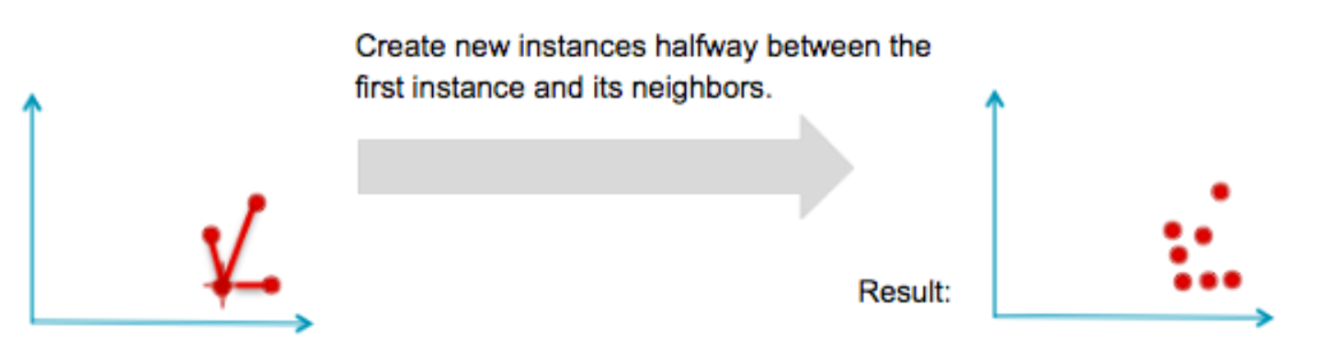
Other Models
Model | Precision | Recall | F1 Score | False Positives | Cost (*)
Naive Bayes Model | 2.72% | 83.33% | 5.27% | 1785 | $195,295
KNN Model | 34.32% | 76.67% | 47.42% | 88 | $15,120
Logistic Regression | 6.99% | 83.33% | 12.90% | 665 | $36,289
SMOTE oversampling on training set to deal with imbalanced dataset
Image source: Tom Hawk, Learning from Imbalanced Classes

Slide 13
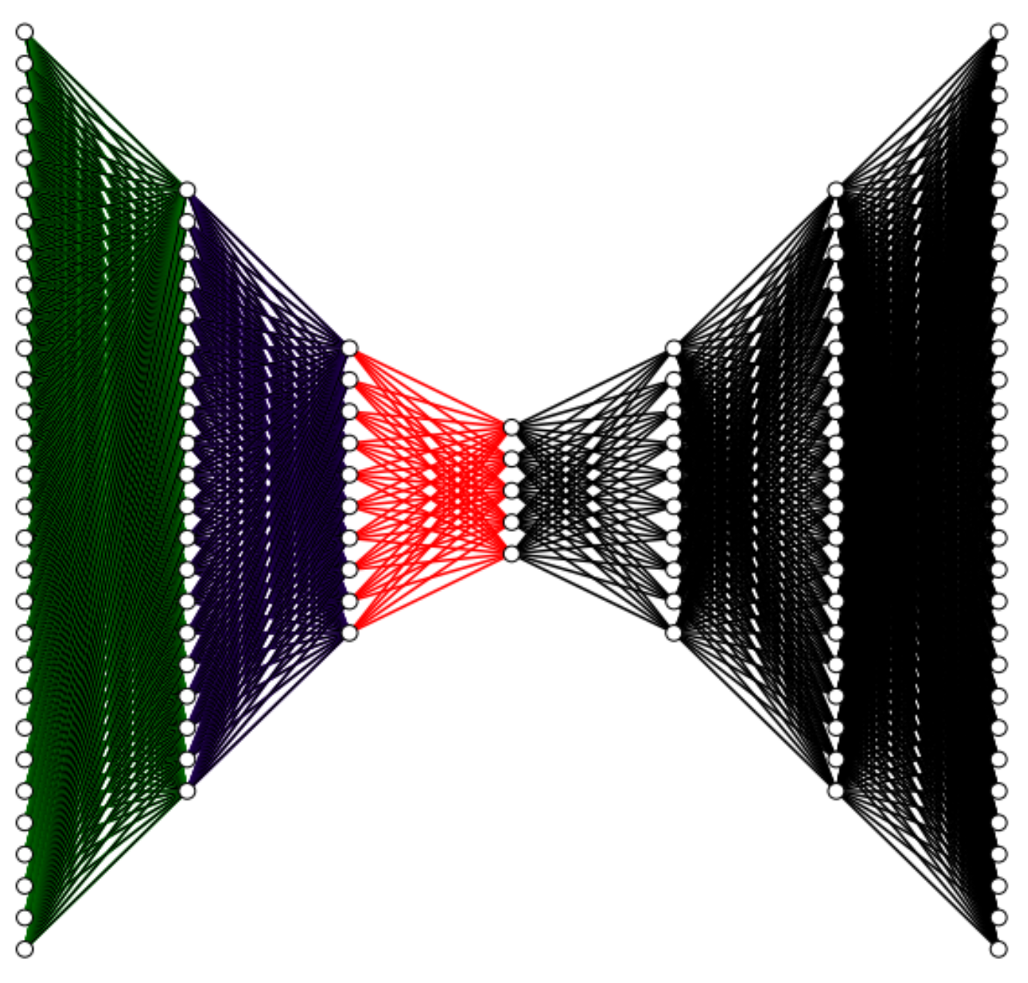
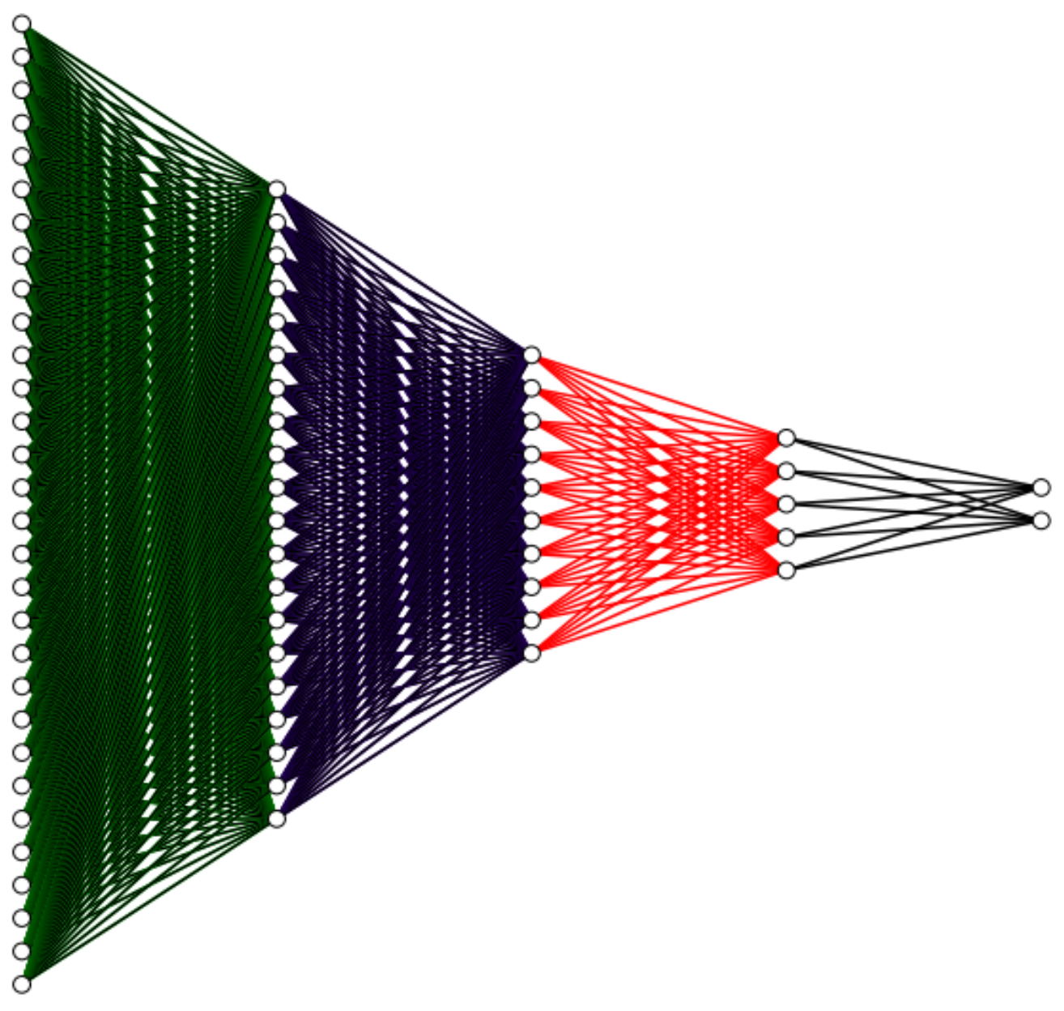
Final Solution
Neural Network + Pre-trained weights from autoencoder
Random Forest with SMOTE oversampling
Unsupervised
Supervised
+
# nodes:
53
20
10
5
10
20
53
53
20
10
5
2

Slide 14
Final Models Summary
Model | Precision | Recall | F1 Score | False Positives | Cost (*)
NN + Pre-trained weights | 75% | 80% | 77.42% | 16 | $2,593
Random Forest Classifier | 90.38% | 78.33% | 83.92% | 5 | $2,529
CONCLUSION :
As seen from the above models, the cost is about 6 to 78 times lower than the previous proposed models.
We have shown that in fraud detection , taking care of the false positives is as important as taking care of the frauds.

Slide 15
THANK YOU

